Slide 1
Project
Easy money
Group 3
ML to ML project

Slide 2
Outline
The Problem
The Analysis
Solution Proposal
Models
KPIs

Slide 3
The Problem

Slide 4
Problem statement
Drop in revenue
lack of understanding of customer base
Too many products
Not all products create revenue

Slide 5
AIM
Increase profits by upselling products to current customers

Slide 6
easyMoney response to problems
Analyse the customer base
Who are our customer
What products are the buying
Analyse our sales
What products generate the revenue
What channels are our customers using to buy products

Slide 7
Data analysis

Slide 8
Product Groups
02
Savings Products:
Pension Plan
Long-term Deposit
Securities
Funds
Short-term Deposit
Accounts Products:
EM Account
EM Account PP
EMC Account
EM Account P
Payroll Account
Debit Card
Finance Products:
Credit Card
Loans
Mortgage
Notes:
exc

Slide 9
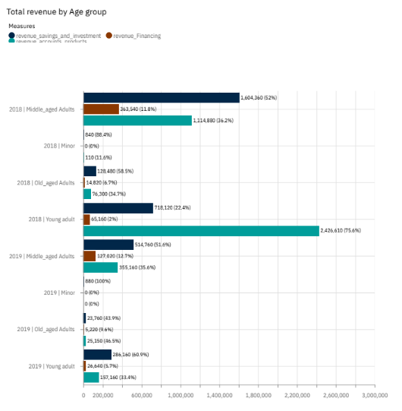
Who are easyMoney customers
01
Notes:
Mostly between 20–40 years old
in the talking points, I plan to say this age group fairly tech-savvy,

Slide 10
What products are the customers buying
Buying
accounts products
debit cards
short-term deposits.
Not Buying
Long-term deposits
mortgages,
Securities
investment funds
03

Slide 11
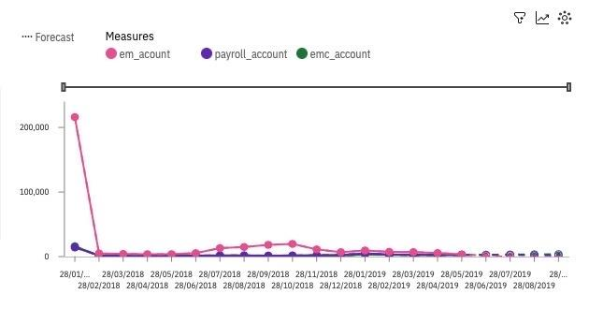
Account product

Slide 12
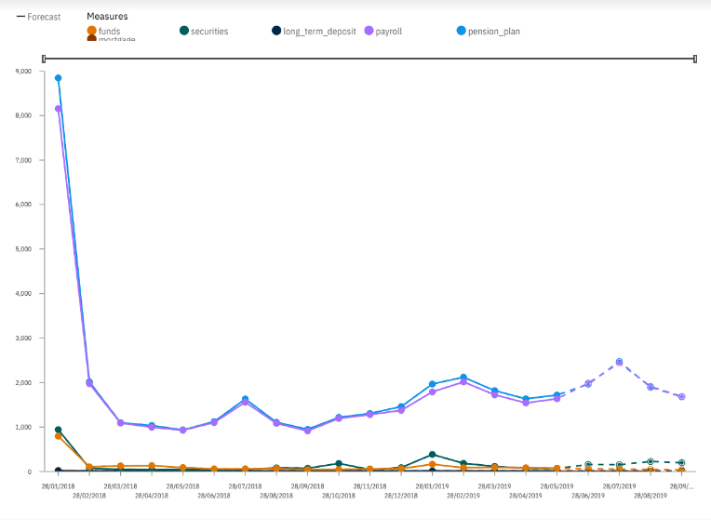
Saving and investment product

Slide 13
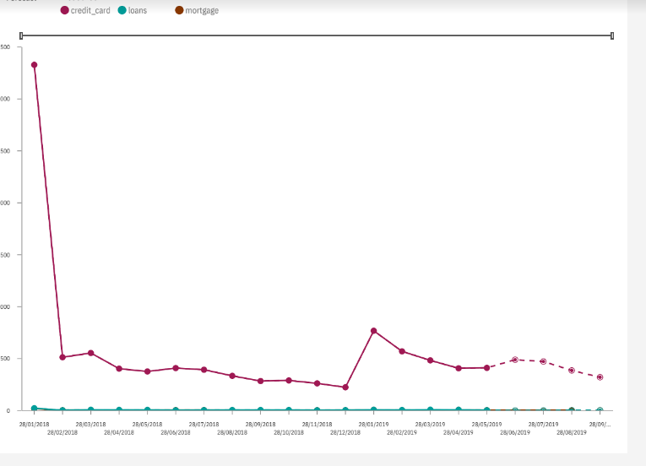
Finance product

Slide 14
Segmentation
Aim
Identify a customer group or groups who have the most chance of increasing the profitability

Slide 15
Segmentation Model
Unsupervised machine learning can be used to group similar customers together
K-means model

Slide 16
Clustering
The need for clustering customers based on these characteristics are
to understand the different customer segments and their behaviors.
Grouping customers with similar characteristics makes it easier to create targeted marketing strategies, allocate resources effectively, improve customer retention rates, and attract new customers.
Clustering also helps identify potential areas for product development and innovation, such as focusing on developing and promoting specific account types or developing more competitive loan products to attract and retain customers.

Slide 17
Clustering
To understand the customers buying patterns and churn groups were created
Segmentation was based on
Products bought per age group
Is the customer likely to continue being a customer
Is the customer new or a long term customer

Slide 18
The most promising segment is 8
Customers in this cluster have a high proportion of "emc_account" and "debit_card" products, which suggests that they use them for everyday transactions.
High proportion of payroll and pension_plan products, indicating that they may be employed and planning for their retirement
low "customer_type__lost"
Highest average of repurchasing products over 70% repurchase at least 1 accounts_products and almost 60% repurchase at least 1 financing_products.

Slide 19
Solution Proposal

Slide 20
Upsell to existing customers
Aim
Create an email campaign for 10, 000 customers.
Recommend a product to them that they are most likely to buy.
Maximize the return of investment.

Slide 21
Strategy
Classification machine learning models will be used to predict for each product group which customers will be most likely to buy the product .
As the aim is to maximize true positives, precision score will be optimized.
3 separate models will be created - one for each group.

Slide 22
Using the past to predict the future
Analyzed customer purchase history for various product segments (credit cards, loans, mortgages, etc.)
Utilized rolling window statistics to measure product usage duration for each customer
Generated new features based on usage duration to improve predictive models
Recommendations for relevant products based on customer behavior led to improved accuracy in product promotion
Notes:
We created a purchase sequence for each customer to understand their historical purchase behavior for the different product segments such as credit cards, loans, mortgages, etc.
We also used rolling window statistics to measure the usage duration of each product for each customer, which helped us create new features to better predict what product to promote next to the customer.
By combining these approaches, we were able to get a more complete view of the customer's behavior and preferences.
This allowed us to build predictive models that recommend the most relevant product to the customer based on their behavior and improving our accuracy in promoting products.

Slide 23
Models

Slide 24

Information architecture
Eeaymoney
Accounts Products
Savings Products
Finance Products
XGB boosting
gradient boosting Classifier
XGB boosting

Slide 25
Models
Accounts Products
Savings Products
Finance Products
The majority of customers bought a target product
Moderately unbalanced
The majority did not buy this product
What was the data like
Accuracy: 0.85
Precision: 0.94
Recall: 0.88
F1-Score: 0.91
Accuracy: 0.8859
Precision: 0.7194
Recall: 0.0818
F1-Score: 0.1470
Accuracy: 0.97
Precision: 0.38
Recall: 0.38
F1-Score: 0.38
Scores validation

Slide 26
Calculating the return of investment
To evaluate the ROI for the campaign, we propose modifying the precision score to account for revenue generated by each product.
Assign weights to each product based on their respective prices:
Account products weighted at 1
Savings and investment products weighted at 4
Finance products weighted at 6

Slide 27
Limitations of this method
Recommendations of ROI
Different models and data sources may introduce inconsistencies when comparing results.
Weights assigned to product categories may not capture individual product value.
suboptimal decisions
missed revenue opportunities.
Precision score may not fully capture the complexity of the decision-making process, as it does not consider:
suboptimal decisions
missed revenue opportunities.

Slide 28
Calculating the return of investment
Recommendations of ROI
Modify the precision score to reflect these weights by calculating precision as follows:
(4 * True Positive Predictions for Savings and Investment) / (4 * Total Positive Predictions for Savings and Investment + 1 * False Positive Predictions for Savings and Investment)
Estimate the expected ROI for each product at various decision thresholds using this modified precision score.
Determine the optimal strategy for the campaign by selecting the threshold that maximizes the expected ROI for each product.

Slide 29
KPIs

Slide 30
KPIs
Demographic Engagement Analysis
Product Performance Analysis.
Product Revenue Growth.
Product Revenue Growth Rate.

Slide 31
Demographic Engagement Analysis
Identification of areas or features where the company is not achieving its goals, in order to reduce costs. Customers were given suggested products based on modelling, and management wants to understand what these products are. Further analysis on market needs, competitive analysis, etc. should be performed to understand whether the product should be developed to meet customer needs or be end-of-life.
Product Performance Analysis
Identification of areas or features where the company is not achieving its goals, in order to reduce costs. Customers were given suggested products based on modelling, and management wants to understand what these products are. Further analysis on market needs, competitive analysis, etc. should be performed to understand whether the product should be developed to meet customer needs or be end-of-life.
Engagement Rate by Demographic Group/Subgroup = (Number of Engagements / Total Number of Contacts) * 100
KPIs

Slide 32
Product Revenue Growth
To improve profitability, the company wants to grow revenue by X percent for each product. This can be measured by looking at the percentage of customers who were contacted about a product and subsequently made a purchase, as well as the percentage of customers who were contacted about a product and then purchased another product.
Product Performance Index = (Total Sales Revenue of the Product / Total Cost to Produce the Product) * 100
The definition of the percentage would need to be made based on many factors, such as cost to develop and maintain product, profit of product and cost of marketing for a particular product.
Product Revenue Growth Rate
Measure the increase in product revenue after the email marketing campaign.
RGR = (Total Revenue of the Product after Marketing Efforts - Total Revenue of the Product before Marketing Efforts) / Total Revenue of the Product before Marketing Efforts * 100
KPIs

Slide 33
Final recommendations
Drop all entry channels that make little or no revenue
Drop products that generate no revenue
Focus marketing key segments
Evaluate if adding more data scientists to the team will add value

Slide 34
Thanks ;)

